Slide 1
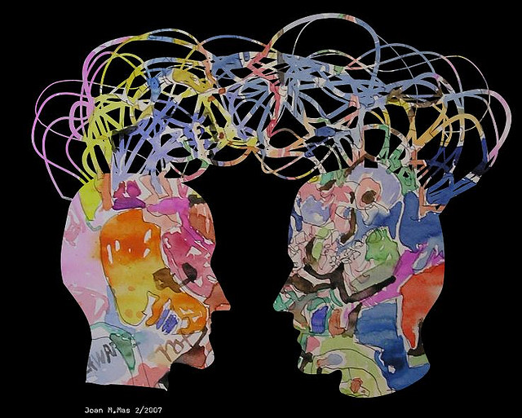

Emotional Intelligence
[Professor Name]
[Class and Section Number]
Notes:
Classroom Recommendations: Emotional Intelligence (EI) is a module that can be taught in one long class period (90-115 minutes) or spread over two shorter class periods. This module would pair nicely with a unit of cognition and intelligence, emotion and motivation, or love and relationships.
Overview: In this module, we review the construct of emotional intelligence by examining its underlying theoretical models, measurement tools, validity, and applications in real-world settings. We use empirical research from the past few decades to support and discuss competing definitions of emotional intelligence and possible future directions for the field.
Technical Note: These slides may contain simple click animation so that you can focus students’ attention on a particular question, a selection of text, or an image and not have them be distracted by reading ahead. You can either preview the sequence of animation by going through the slides in slideshow view, visiting the animations tab, or reviewing the slide notes. In the notes you will see a cue - (Click) – that corresponds to each animation.
You may also find hyperlinks to outside videos at various places in the slides. These hyperlinks are embedded in text and indicated by color and in the notes section.

Slide 2
Today’s Learning Objectives
Understand the theoretical foundations of emotional intelligence and the relationship between emotion and cognition.
Distinguish between mixed and ability models of emotional intelligence.
Understand various methods for measuring emotional intelligence.
Describe the evolution of emotional intelligence as a theoretical, success-oriented, and achievement-based framework.
Identify and define key concepts of emotional intelligence (including emotion regulation, expression of emotion, understanding emotion, etc.) and the ways they contribute to decision making, relationship building, and overall well-being.
Notes:
These learning objectives are the Module Learning Objectives as stated at the start of the module.

Slide 3

Warm Up
Take a few minutes. In 1-2 sentences answer the following:
What is Emotional Intelligence?
Why is it important to understand EI?
Notes:
This slide introduces the Warm-Up Activity
If using the slide here: tell students you want to get a sense of what they know.
This is a good Think, Pair, Share activity. (TPS is when you want to give students a chance to THINK and write down their answers to a question(s), then to Pair Up with someone next to them and talk about what they thought, and then SHARE with the whole class).
Take a few minutes and in 1-2 sentences answer the following questions:
(Click): What is emotional intelligence?
(Click): Why is it important to understand emotional intelligence?
Alternative:
Consider moving this slide before the title slide if you want to give students something to do as they enter the classroom and prepare for the class session.
Have this slide visible to students as they enter the classroom before class starts and for the first few minutes of class time.
This can be collected as a measure of on-time attendance.

Slide 4
Overview
What is Emotional Intelligence (EI)?
Ability Models
  The Four-Branch Model
Mixed and Trait Models
  The Boyatziz-Goleman Model
  The Bar-On Model
  The Trait EI Model
Room for Debate
Practical Application
  Workplace
  School
Limitations and Future Directions
Notes:
This slide provides students with an overview of the material that will be covered during the lecture

Slide 5

What is EI?
Emotional Intelligence – or EI – is the intersection of emotions and cognition and the ability to leverage emotions to enhance thinking, judgment, & behavior.
Notes:
This slide presents an overview of what Emotional Intelligence is. This can be used in tandem with the discussion of the answers to the warm-up question.
This slide can be a way to ascertain how much of this material students already know, understand and can articulate. You may want to break down words like “intersection” and “leverage” for students. A simpler definition might be “EI is when emotions and how you think work together to use the emotions to enhance thinking, judgment, and behavior.

Slide 6
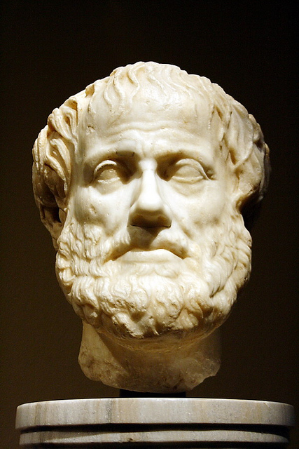
History of EI?
Two domains: Intelligence & Emotions
  Aristotle
Limitations to IQ led to new theories
  Gardner and Sternberg
Goleman theory of EI
Why aren’t we more compassionate?
Notes:
The purpose of this slide is to discuss the history of emotional intelligence
(Click): Two domains: Intelligence and Emotions
Traditionally cognition and emotions have been viewed as separate domains with emotion an impediment to cognition.
(Click): Aristotle
While there are traces that emotional arousal is positive, dating to Aristotle, cultural norms generally teach us to be tough and repress emotional thinking.
(Click): Limitations to IQ led to new theories
In the 1970s scientists began to recognize limitations of the Intelligence Quotient (IQ), specifically with its inability to explain individual differences unrelated to just cognitive ability.
(Click): Gardner and Sternberg
Additionally Gardner and Sternberg presented more inclusive theories of intelligence leading the way for researchers to begin exploring the influences of emotion on thinking, judgment, and memory.
(Click): Goleman Theory of EI
Today EI is an extensive and varied field with multiple perspectives and measurement tools. Daniel Goleman’s book, Emotional Intelligence: Why It Can Matter More Than IQ (1996), presents a theory of EI that blends emotion-related skills, cognitive intelligence and personality. The public appeal generated by the book was one catalyst for the growth in EI research, but also was a contributor to conflicting definitional and measurement models.
(Click): Why aren’t we more compassionate?
VIDEO LINK (running time 13:13)
Goleman, D. (2007, March) Daniel Goleman: Why aren’t we more compassionate? [Video file]. Retrieved from http://www.ted.com/talks/daniel_goleman_on_compassion?language=en
See OUTSIDE RESOURCES for additional video options.
Discussion Questions After the Video:
Do the people in the examples in this talk exhibit emotional intelligence? Why or why not?
You may discuss the examples of the Princeton University Good Samaritan Study, the examples of narcissism and altruism that the author himself has experienced, focusing on the other person while dating or at work, turning off the ‘urban trance’ while being out on the street and any other examples that you notice in the video.
How does this show the development of emotional intelligence as a field of it’s own [rather than cognition and emotion as separate domains]?
You may discuss the example of the field of social neuroscience that studies the EI from a unique standpoint, discuss the example of making the compassionate choice which requires knowledge about the product you’re selecting as well as having an emotional reaction to people being harmed while making the product, or noticing a homeless person on the street requires both paying attention (cognition) and feeling empathy (emotion) for him/her, and any other examples you may have noticed in this video. As a counterpoint, you may discuss the notion that IQ has a zero correlation to empathy, as the lecturer in this video asserts.
Why and how do our emotions affect our actions?
You may discuss the fact that we don’t take every opportunity we have to help because our focus is in the wrong direction, but once we reverse the self-other focus and pay attention, we are will feel empathy and help another person because human beings have a default mirror neuron wiring to help – known as automatic empathy, and discuss any other examples/explanations you’ve found in this video.
Reference:
Daniel, G. (1996). Emotional Intelligence: Why it can matter more than IQ. Toronto, Canada: Bantam Book.

Slide 7
Overview
What is Emotional Intelligence?
Ability Models
  The Four-Branch Model
Mixed and Trait Models
  The Boyatziz-Goleman Model
  The Bar-On Model
  The Trait EI Model
Room for Debate
Practical Application
  Workplace
  School
Limitations and Future Directions
Notes:
Mid-Lecture Overview

Slide 8

Four-Branch Model
Perception of Emotion
Identify emotions of self
Identify emotions of others
Use of Emotion to Facilitate Thinking
Differing emotions have a differing impact on a situation
Notes:
This slide and the next one are meant to facilitate an overview of the Four-Branch Model of Emotional Intelligence.
The Four-Branch Model is an ability model and is comprised of 4 parts; 2 of which are described on this slide and 2 on the next.
From the Module:
“This model proposes that four fundamental emotion-related abilities comprise EI: (1) perception/expression of emotion, (2) use of emotion to facilitate thinking, (3) understanding of emotion, and (4) management of emotion in oneself and others.”
(Click): Perception of Emotion
(Click): Identify emotions of self
(Click): Identify emotions of others
The ability for people to identify their emotions and the emotions of others through emotional displays.
Discussion Question:
Ask the class to identify different emotions they might feel in different situations.
(Click): Use of Emotion to Facilitate Thinking
(Click): Differing emotions have a differing impact on a situation
Use the upcoming discussion questions to expand on this idea and apply these concepts to real-world situations.
Discussion Question:
Ask the class to think about a stressful situation in which they might have to make decisions (sick pet, car accident) and what emotions could be helpful or hurtful in this situation and why.
In the case of a sick pet. Emotions could be helpful in empathizing with pain the pet may be in and how to treat the sickness. Or emotions could be potentially harmful in love for a pet prompting extraordinary measures to keep the pet with us rather than allowing the pet to pass.
After a car accident some logical decisions may be:
to contact the insurance company for your car and possibly someone else’s car or property
medical care for yourself, passengers or others,
determining who is at fault, etc.,
and it is actually suppressing of emotions that may be beneficial in aiding the decision-making process in this situation. However, feeling fear, anxiety or anger may actually impede the decision-making process.

Slide 9
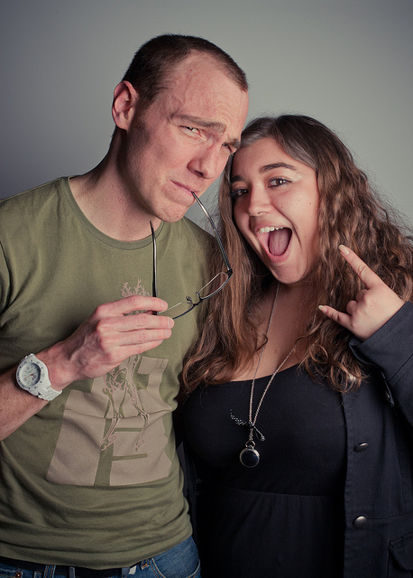
Four-Branch Model
Understanding of Emotion
Where do emotions come from?
How do various emotions work together?
Management of Emotion
How to feel emotion and display appropriately
Notes:
This slide and the previous slide are meant to facilitate an overview of the Four-Branch Model of Emotional Intelligence
(Click): Understanding of Emotion
(Click): Where do emotions come from?
The ability to separate emotional states and see variations based on the cause of the emotion.
(Click): How do various emotions work together?
Additionally this ability is seeing how multiple emotions work together. The ability to successfully discriminate between negative emotions may lead to more effective emotion management.
Watch Understanding of Emotion Video:
The video link here is to a YouTube clip from Harry Potter and the Order of the Phoenix. The video shows Hermione explaining to Harry and Ron the complexity of what Cho Chang is feeling ending with “Just because you have the emotional range of a teaspoon”.
https://www.youtube.com/watch?v=ogZMzVWMQao
Discussion Question:
Discuss the emotional complexity described here and how it could affect decision making. If most of the class is familiar with the Harry Potter series, this complexity could be discussed in how if affects Cho’s decision making.
(Click): Management of Emotion
The ability to recognize the value of all emotions in appropriate contexts and the appropriate outlet for emotion (i.e., allowing yourself to feel angry, but not reacting violently and hurting someone).
Discussion Question:
Discuss appropriate and inappropriate emotional displays. Are there ever times when an “inappropriate” display may be socially acceptable.
Examples of Appropriate Emotional Displays:
Cheering and celebrating when your favorite sports team wins a big game
Crying at a wake or funeral
Examples of Inappropriate Emotional Displays
Rioting and destroying property
Showing anger and yelling at someone, essentially an adult tantrum
Example of when an “inappropriate display” is acceptable
Rioting and destroying property in celebration after your favorite sports team wins a big game (while everyone would not see this as acceptable, there are some who would)
When someone is experiencing grief such as the death of a parent or child, displays of anger and blaming others would be more likely to be understood as acceptable

Slide 10

Four-Branch Model
Performance Measures in Four-Branch Model
Emotion problems in four areas
Eight tasks for people to complete
Notes:
This slide is meant to cover performance measures and how people are assessed in this manner.
(Click): Performance Measures
Performance measures, rather than self-report are used to measure EI in this model.
(Click): Emotion Problems in four areas
(Click): Eight tasks for people to complete
These measures require respondents to demonstrate the four emotion skills through eight tasks. In each task, an emotional scenario is presented and the respondent is asked to evaluate different resolutions. Most commonly used is the Mayer-Salovey-Caruso EI Test (MSCEIT) which consists of 141 questions that measure Perception of Emotion, Use of Emotion to Facilitate Thinking, Understanding of Emotion, and Management of Emotion through eight tasks:
Each of the four areas is measured through 2 sub-scales with questions answered with a Likert-type scale.
Test website: http://www.eiconsortium.org/measures/msceit.html
PlosOne article about test: http://journals.plos.org/plosone/article?id=10.1371/journal.pone.0098827
Discussion Question:
Discuss pros and cons of this type of measurement/assessment.
Pros: easy to assess many people, everyone has the same questions, answers can be compared across subjects.
Cons: people may have skills not captured by questions on a paper and pencil test.

Slide 11
Overview
What is Emotional Intelligence?
Ability Models
  The Four-Branch Model
Mixed and Trait Models
  The Boyatziz-Goleman Model
  The Bar-On Model
  The Trait EI Model
Room for Debate
Practical Application
  Workplace
  School
Limitations and Future Directions
Notes:
Mid-Lecture Overview

Slide 12

Mixed Models
Boyatziz-Goleman
Self-awareness
Self-management
Social awareness
Relationship management
Bar-On
Intrapersonal skills
Interpersonal skills
Adaptability
Stress management
Mood
What are the similarities and differences of these two models in assessing EI?
Notes:
This slide covers two Mixed Models of EI.
(Click): Boyatziz-Goleman Model:
(Click): Self-Awareness
(Click): Self-Management
(Click): Social Awareness
(Click): Relationship Management
(Click): Bar-On Model
(Click): Intrapersonal Skills
(Click): Interpersonal Skills
(Click): Adaptability
(Click): Stress Management
(Click): Mood
(Click): Discussion Question:
What are the similarities and differences of these two models in assessing emotional intelligence?
Talk about the emotional domains covered for each and discuss the similarities and differences in these:
The B-G model seems to cover only intrapersonal and interpersonal skills, which are included in the Bar-On model
The Bar-On model includes additional factors, adaptability, stress management and mood.
Additionally, you can discuss the similarities and differences with the Four-Branch Model:
The Four-Branch model uses: Perception of Emotion, Use of Emotion to Facilitate Thinking, Understanding of Emotion, and Management of Emotion.
Facilitate Thinking and Understanding of Emotion are not specifically covered under the Boyatziz-Goleman and Bar-On models.

Slide 13
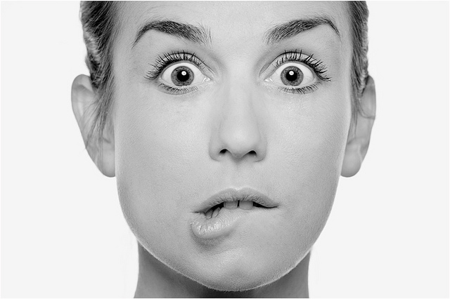
Trait EI Model
EI is a constellation of self-perceived, emotion-related personality traits.
Notes:
This slide presents information about the trait EI model.
According to Trait Emotional Intelligence Model, EI is a constellation of self-perceived, emotion-related personality traits.
Discussion Questions:
What does this definition mean?
It is up to the individual to self-perceive their emotional intelligence.
How is this similar or different with the models discussed?
Rather than being measurable through tests, the trait model is self-perceived. There are no specific categories of skills that make up EI.
Wikipedia provides this further information https://en.wikipedia.org/wiki/Emotional_intelligence#Trait_model
Alternative Sources of Information:
http://www.psychometriclab.com/admins/files/EJP%20(2001)%20-%20T_EI.pdf
http://www.researchgate.net/profile/Vincent_Egan/publication/222698367_Personality_well-being_and_health_correlates_of_trait_emotional_intelligence/links/004635152ed98bec4f000000.pdf
http://www.psychometriclab.com/admins/files/measuring%20trait%20ei%20(chapter).pdf
http://www.psychometriclab.com/admins/files/IOPS%20(2010)%20-%20TEI.pdf

Slide 14

Mixed and Trait Model
Self-Report Measures
Perception of emotional skills
Quick to administer
Vulnerable to bias
Notes:
This slide discusses self-report measures the pros and cons of this form of measurement.
(Click): Self-Report Measures
Mixed and trait EI models are evaluated through self-report measures.
(Click): Perception of Emotional Skills
(Click): Quick to Administer
(Click): Vulnerable to Bias
There is some argument as to the validity of these measures as people may fall prey to social desirability biases and inflate personal abilities and skills. There’s also a low correlation between self-report measures and performance measures.
Discussion Question:
What are the pros and cons of ability measures?
Pros: May cover more skills than a set of closed-ended questions.
Cons: People’s perceptions of their own abilities may be inaccurate.

Slide 15
Last Word
Stand in a circle – OR – a group comes to the front of class.
Story starts with first line.
Each person gives one line of the story.
The last word of sentence before is first word of your sentence.
Have fun!
He realized the child had seen him and he couldn’t let him get away.
Notes:
This slide introduces the Last Word Activity
Instructions for Students:
(Click): Stand or sit in a circle – OR – A group comes to the front of the class
(Click): The story will start with the first line, provided by the instructor
(Click): Each person gives one line of the story
(Click): The last word of the previous sentence must be used as the first word of your sentence.
(Click): Have fun!
Directions for Instructors:
You should have 8 or more participants. If you have a small class you could potentially do this with the entire class if you sit in a large circle. This activity also lends itself to a front-of-class performance.
Player #1 begins a story based on a suggestion, using 1 sentence. The last word of that sentence becomes the first word of the next players' sentence, and so on. The 1-sentence at a time story develops until it reaches some sort of conclusion.
You may want to create a list of potential first lines or topics if your students are stumped. Here are some examples or you may use a first line generator.
• She opened the wrong door…
• His loved cooking.
• She didn’t know she had superpowers.
You may want to set some ground rules such as: no explicit sexual references, no explicit language, no graphic violence, no racial or derogatory terms.
First line generator: ( http://writingexercises.co.uk/firstlinegenerator.php ) or (http://writers-den.pantomimepony.co.uk/writers-first-lines.php )
For each exercise ask students to remain aware of their emotional response. This includes cognitive (i.e. how it makes them feel) as well as physiological (i.e., rapid pulse) responses.
ENDING THIS ACTIVITY: the instructor acts as facilitator and can choose when the story ends. It might happen after each member of the group has had a turn although it is also possible that the story naturally comes to a close before or after that point. Use your own judgment about when best to stop.
Use the next slide as a wrap up discussion that includes the discussion on the students’ emotional response. Next Slide →

Slide 16
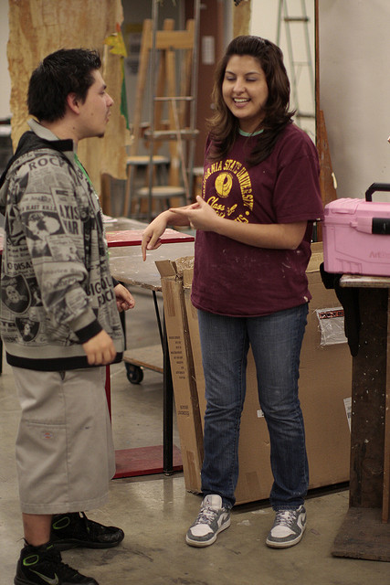
Improvisation: Discussion
How did that make you feel?
Emotional vulnerability: an enhancement or detriment?
Is this type of activity an accurate way to measure EI?
Notes:
This slide accompanies the activity introduced in on the previous slide.
Ask students these questions to guide the discussion of how this activity relates to EI. Use the EI learning objectives to discuss specifically how students may have felt they did on each point.
Last Word Learning Objectives: creative communication; focused listening that strengthens interpersonal connections; self-awareness that develops though discussion of one’s internal mental and emotional process during the exercise; develop tolerance for uncertainty and the dynamic unfolding of an interaction
Discussion Questions:
How did that make you feel?
-- Here you can discuss overall feelings, or more specific feelings. You might point students’ attention toward how they felt as it came closer to being their turn, how it felt during their turn, and how it felt after their turn.
-- You might also point out and validate individual differences in emotional experience. Some students will feel nervous or self-conscious while others will have fun and feel relaxed.
-- Refer to the models we have discussed (the Four-Branch, Boyatziz-Goleman, and Bar-On) and think about which model might best explain your emotional state.
Was the emotional vulnerability an enhancement or detriment to your performance?
Where does this feeling and performance fit into the different models of EI?
-- students might mention ways in which nervousness interfered with thinking or the ways in which feeling relaxed boosted motivation
Do you think that this type of activity could be an accurate way to measure EI?
Talk about what kind of measure this is - performance or ability - and the pros and cons of using performance as a measure of EI.

Slide 17
Overview
What is Emotional Intelligence?
Ability Models
  The Four-Branch Model
Mixed and Trait Models
  The Boyatziz-Goleman Model
  The Bar-On Model
  The Trait EI Model
Room for Debate
Practical Application
  Workplace
  School
Limitations and Future Directions
Notes:
Mid-Lecture Overview

Slide 18
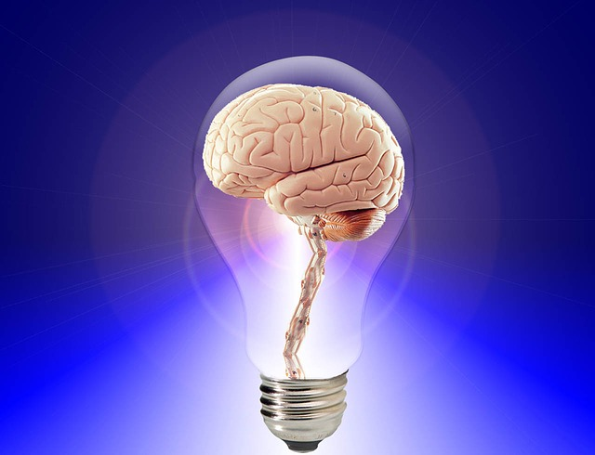
Which Model is Right?
Ability models allow for growth in EI, it is a skillset that can be learned.
Mixed and Trait models focus on personality traits that are somewhat fixed by adulthood, suggesting little change is possible.
How is EI different from personality traits?
Notes:
This slide introduces the discussion and review of the EI models
(Click): Ability models allow for growth in EI, it is a skillset that can be learned
(Click): Mixed and Trait models focus on personality traits that are somewhat fixed by adulthood, suggesting little change is possible.
(Click): How is EI different from personality traits?
Talk about Emotional Intelligence and how it differs from personality.
A person can have a nice and engaging personality, but not have good emotional regulation which may put stress on some relationships as the person is emotionally volatile
A person may not have many friends or get along well with others, yet still have high EI which may show as this person reacts well and remains calm in stressful situations
Additional Discussion Questions:
Do you think that EI can be learned? What are some skills that are learned versus those that are fixed?
Can a person’s personality change? If personality is fixed does that mean EI is fixed as well?
Do some models of EI (Four-Branch, Boyatziz-Goleman, Bar-On, Trait) work better than others depending on how you answer the above questions?

Slide 19
Overview
What is Emotional Intelligence?
Ability Models
  The Four-Branch Model
Mixed and Trait Models
  The Boyatziz-Goleman Model
  The Bar-On Model
  The Trait EI Model
Room for Debate
Practical Application
  Workplace
  School
Limitations and Future Directions
Notes:
Mid-Lecture Overview

Slide 20

Application: Workplace
EI & Performance
Company rank
Merit raises
EI & Leadership
Motivate
Empower
Inspire
Notes:
This slide presents some of the benefits of high EI in the workplace.
(Click): EI & Performance
EI is correlated with performance. Correlations have been found between EI and enhanced job performance, occupational well-being, and leadership effectiveness.
(Click): Company Rank
(Click): Merit Raises
EI has been associated with performance indicators such as company rank and percent merit increase, and successful managerial skills such as problem solving and negotiation.
(Click): EI & Leadership
(Click): Motivate
(Click): Empower
(Click): Inspire
Leaders also benefit from high EI. Transformational leaders, who motivate, empower, and inspire followers, have been shown to have high EI.

Slide 21

Application: School
Teacher - Emotional State
Influences whole class
Emotion management needed to keep a functional classroom
Job satisfaction
Notes:
This slide discusses how EI is relevant in schools.
(Click): Teacher Emotional State
Teacher emotional state is related to job satisfaction and a sense of personal accomplishment.
(Click): Influences the whole class
A teacher’s emotional state influences the entire classroom.
(Click): Emotion management is needed to keep a functional classroom
Effective teachers need the ability to manage their own emotions in order to keep a positive and functional classroom environment and also to help manage and direct the emotions of students. Research suggests that high EI is important for effective teaching, as teachers must manage negative emotions in order to keep a positive and functional classroom.
(Click): Job Satisfaction
Emotional regulation has been associated with job performance and satisfaction as well as support from principals.

Slide 22

Application: School
Social Emotional Curriculum
Merges thinking, feeling, and behavior
Student Emotion Regulation
Personal success
Academic success
RULER program
Notes:
This slide continues the discussion on how EI is relevant in schools.
(Click): Social Emotional Curriculum
(Click): Merges thinking, feeling and behavior
Social Emotional Learning is related to EI. This type of curriculum integrates thinking, feeling, and behavior.
(Click): Student Emotion Regulation
Emotional regulation can help students focus in class and manage academic anxiety. Schools that used the RULER curriculum, were rated with higher warmth and connectedness between teachers and students.
(Click): Personal Success
(Click): Academic Success
EI embedded in social emotion curriculum contributes to personal and academic success.
(Click): RULER program
RULER program was developed at Yale University Center of Emotional Intelligence
RULER Stands for:
Recognizing Emotions in Self and Others
Understanding the Causes and Consequences of Emotions
Labeling Emotions Accurately
Expressing Emotions Appropriately
Regulating Emotions Effectively
Source: Yale Center for Emotional Intelligence (2015). RULER Overview. Retrieved from: http://ei.yale.edu/ruler/ruler-overview/

Slide 23
Overview
What is Emotional Intelligence?
Ability Models
  The Four-Branch Model
Mixed and Trait Models
  The Boyatziz-Goleman Model
  The Bar-On Model
  The Trait EI Model
Room for Debate
Practical Application
  Workplace
  School
Limitations and Future Directions
Notes:
Mid-Lecture Overview

Slide 24
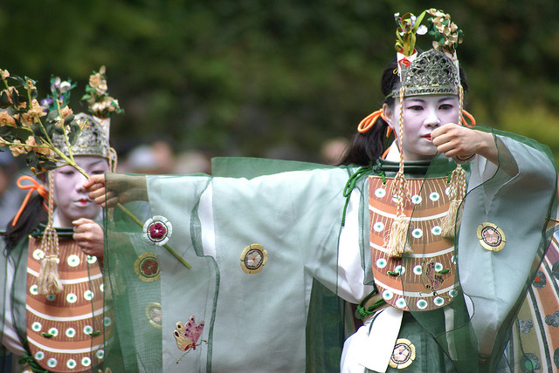
Limitations & Future Directions
Development of new theory
New forms of measurement
Cross-cultural research
Notes:
This slide lists some of the research that is needed in this field.
(Click): Development of New Theory
More research and development of EI theory and measurement is needed. It is important for the field to reconcile conflicting definitions and to refine existing measures.
(Click): New Forms of Measurement
The primary performance assessment of EI, MSCEIT (The Mayer-Salovey-Caruso Emotional Intelligence Test (find more information on http://www.eiconsortium.org/measures/msceit.html) is limited in that it does not allow assessment of abilities such as the expression of emotion and emotional self-reflection. There are also questions as to the construct validity of EI.
(Click): Cross-Cultural Research
Cross-cultural research is needed to achieve possible universal applications and outcomes. However, current findings do indicate a relationship between cognition and emotion. EI gives us ownership over our emotions and allows for individual agency in any situation.
Down-regulating emotions may allow a person to re-direct focus to the situation and not the emotional response, allowing a more objective view of the point of conflict.

Slide 25

Wrap Up Activity
Imagine…
Notes:
This slide introduces the Wrap Up Activity
Give students the scenario from the textbook, read it aloud:
Imagine you are waiting in line to buy tickets to see your favorite band. Knowing tickets are limited and prices will rise quickly, you showed up 4 hours early. Unfortunately, so did everyone else. The line stretches for blocks and hasn’t moved since you arrived. It starts to rain. You are now close to the Will Call when you notice three people jump ahead of you to join their friends, who appear to have been saving a spot for them. They talk loudly on their cell phones as you inch forward, following the slow procession of others waiting in line. You finally reach the ticket counter only to have the clerk tell you the show is sold out. You notice the loud group off to the side, waving their tickets in the air. At this exact moment, a fiery line of emotion shoots through your whole body. Your heart begins to race, and you feel the urge to either slam your hands on the counter or scream in the face of those you believe have slighted you.
Then have students take no more than five minutes to respond to the questions on the Next Slide →

Slide 26

Wrap Up Activity
What is best approach?
Should you talk to the clerk or the manager?
Would you let the group know how you felt?
Other suggestions?
Notes:
This slide contains the Discussion Questions for the Wrap Up Activity
Discussion Questions:
(Click): In your opinion What is the best approach?
(Click): Should you talk to the ticket clerk or ask to see the sales manager?
(Click): Would you let the group know how you felt when they cut in line?
(Click): Other suggestions as to how to handle the situation?

Slide 27

CAT: One-Minute Paper
  Let’s revisit the questions in the Warm Up Activity
    What is emotional intelligence?
    Why is it important to understand emotional intelligence?
  Take one-minute to write down something you learned that changes or confirms how you answered these questions.
Notes:
Classroom Assessment Technique (CAT): One-Minute Paper
The One - Minute Paper tests whether students are gaining knowledge, or not.
The instructor ends class by asking students the following questions: “What is emotional intelligence? and Why is it important to understand emotional intelligence? After a brief discussion, the instructor asks students to take one minute to write down something they’ve learned that either changes of confirms how you answered these questions.
After class, review the results, determine what they tell you about your students’ learning, and decide what changes to make, if any.
Let your students know what you learned from the CAT and how you will use this information.
If you do not conclude with this Classroom Assessment Technique (CAT), it would helpful to use another CAT. It could be in the form of a:
Muddy point
One-minute paper
Background knowledge
What’s the Principle?
Defining features Matrix:
For more information on CATs click here: http://cft.vanderbilt.edu/guides-sub-pages/cats/

Slide 28
Photo Attribution
Slide 1 | Photo Credit: Communication Joan M. Mas https://www.flickr.com/photos/dailypic/1459055735 https://creativecommons.org/licenses/by-nc/2.0/
Slide 3 | Photo Credit: Emotion Mbragion https://pixabay.com/en/emotion-cry-faith-search-thrill-556794/ https://creativecommons.org/publicdomain/zero/1.0/deed.en
Slide 5 | Photo Credit: Ist das die Sonne? Day 45 Arwen Abenstern – KWP https://www.flickr.com/photos/arwen-abendstern/1860682273/ https://creativecommons.org/licenses/by/2.0/
Slide 6 | Photo Credit: Viena-Wien. Kunsthistorisches Museum. Cap d'Aristòtil. Còpia romana d'un original grec. Ca. 320 dC. Pilar Torres https://www.flickr.com/photos/33014459@N02/8541381785/ https://creativecommons.org/licenses/by-nc-sa/2.0/
Slide 8 | Photo Credit: day 041. Holly Lay https://www.flickr.com/photos/48337528@N05/4661253331/ https://creativecommons.org/licenses/by/2.0/
Slide 9 | Photo Credit: IMG_5293 Katya Mokolo https://www.flickr.com/photos/diabolikkitsuney/5617206058/ https://creativecommons.org/licenses/by-nc-nd/2.0/
Slide 10 | Photo Credit: Bibliography Alexandre Duret-Lutz https://www.flickr.com/photos/gadl/320300354 https://creativecommons.org/licenses/by-sa/2.0/
Slide 12 | Photo Credit: . Khánh Hmoong https://www.flickr.com/photos/7997148@N05/9916783866/ https://creativecommons.org/licenses/by-nc/2.0/
Slide 13 | Photo Credit: Untitled Thierry DECKER https://www.flickr.com/photos/61928349@N07/6537902233/ https://creativecommons.org/licenses/by-nc-sa/2.0/
Slide 14 | Photo Credit: Day 26--The pen(cil) is mightier than the sword Brandy https://www.flickr.com/photos/58372737@N00/384440324/ https://creativecommons.org/licenses/by-nc/2.0/
Notes:
Photo Attribution Slide

Slide 29
Photo Attribution
Slide 16 | Photo Credit: Kevin Jovan Palma & Erica Gonzalez Parker Knight https://www.flickr.com/photos/rocketboom/4400482681 https://creativecommons.org/licenses/by/2.0/
Slide 18 | Photo Credit: Brain PublicDomainPictures https://pixabay.com/en/brain-think-human-idea-20424/ https://creativecommons.org/publicdomain/zero/1.0/deed.en
Slide 20 | Photo Credit: @monsieurzac Kitsuney https://www.flickr.com/photos/diabolikkitsuney/5616615215/ https://creativecommons.org/licenses/by-nc-nd/2.0/
Slide 21 | Photo Credit: What the teacher is, is more important than what he teaches BK https://www.flickr.com/photos/pictoquotes/9564495044 https://creativecommons.org/licenses/by-nc/2.0/
Slide 22 | Photo Credit: IMG_8341 Cavalier92 https://www.flickr.com/photos/cavalier92/4516045597 https://creativecommons.org/licenses/by-nc-nd/2.0/
Slide 24 | Photo Credit: A set on Mifune Matsuri 01 Aurelio Asiain https://www.flickr.com/photos/75008966@N00/507026834/ https://creativecommons.org/licenses/by-nc-nd/2.0/
Slide 25 | Photo Credit: Line of People – Paris SAITOR https://www.flickr.com/photos/82187889@N00/2227603068/ https://creativecommons.org/licenses/by-nc-sa/2.0/
Slide 26 | Photo Credit: Self-Portrait Jorrit Punter https://www.flickr.com/photos/62821507@N03/7052574663/ https://creativecommons.org/licenses/by-nc-sa/2.0/
Slide 27 | Photo Credit: Illustrated silhouette of a black cat nehtaeh79 http://www.freestockphotos.biz/stockphoto/16624 http://creativecommons.org/publicdomain/zero/1.0/
Notes:
Photo Attribution Slide

